Slide 1
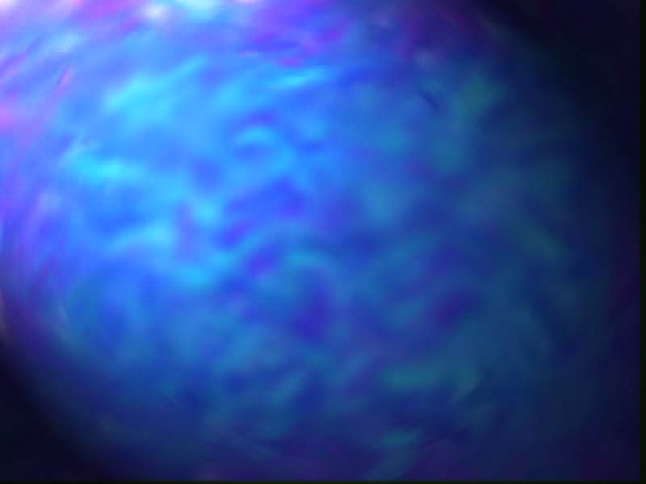
Two Solutions to
Crossing Prisms
STYC

Slide 2
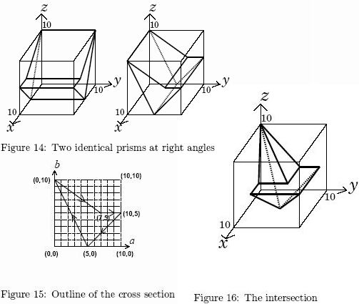
Problem Description
Given a prism, calculate the surface area of the intersection of two of it crossed at right angle.
The outline of the prism is either a triangle or a simple quadrilateral.

Slide 3
A Straightforward Idea
Decompose the surface of the polyhedron of intersection into separate faces. Calculate the area of each face and sum it up.
Two different cases to handle: horizontal faces & non-horizontal faces.
This requires spatial imagination, which is weak with me… To be discussed later.

Slide 4
An Idea with Trick
If we thicken the polyhedron by a small dr, causing an small increase of its volume dV, then dV/dr is approximately the surface area. Error can be controlled by dr and the precision of volume calculation.
Volume can be calculated using numerical integration. I love this!

Slide 5
Thicken the Polyhedron
Obviously, to thicken the polyhedron is to enlarge the prism that makes it.
To enlarge the prism is to shift each of its edges perpendicularly to itself by dr. Then they are extended to determine the vertices of the enlarged prism.
Ordinary analytical geometry VS Computational geometry

Slide 6
Vertex Determination &
Edge Shift
The straightforward method of shifting all lines on which the edges lie and solving linear equations for their intersections requires many floating-point operations, thus reducing precision while consuming much time.
A good attempt is to determine the vertices directly from the known edges.

Slide 7
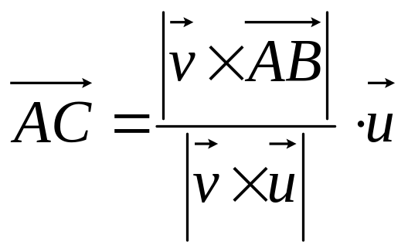
Vertex Determination &
Edge Shift – An Example
C
B
u
v
u
dr
A
dr
v

Slide 8
Volume Calculation
As aforementioned, we are going to do the calculation using numerical integration.
Use a plane that is parallel to the O-xy plane to slice the polyhedron. Calculate the area S of every slice and integrate S over the height of the slice.

Slide 9
Slice Area Calculation
Use a horizontal line to slice the prism, the wanted slice area is the squared sum of the lengths of all intersections of the line and the prism.
Employ the same method used in vertex determination to find the intersections.

Slide 10
Implementation Notes
Some prisms may have three points on a straight line. These prisms need to be simplified.
Calculate the area from multiple dr’s (some may be negative), use an arithmetic/weighted mean to reduce error.

Slide 11
Implementation Notes
Vector operations can be done with complex numbers.
Mind the time-precision trade-off. Better precision needs more time.

Slide 12
The Straightforward Way
General idea: The area of a planar polygon is equal to the area projected on a plane divided by the cosine of the angle between the mentioned plane and the plane on which the polygon lies.
Non-horizontal edges (faces) and horizontal edges (faces) should be considered separately because the surface area comes from them in different manners.

Slide 13
Non-horizontal Edges
Each non-horizontal edge represents one rectangular face of the prism. The shape of the surface area which lies on the face is almost the same as the outline of the prism, probably stretched due to projection and chopped if the face does not cover the whole height of the polyhedron.
The general idea is applied here.

Slide 14
Horizontal Edges
Projected area of any horizontal edge on a non-horizontal face is zero. It should be calculated in a different way.
Two different cases: The edge is the top or the bottom of the prism; the edge cuts through the prism.

Slide 15
Horizontal Edges
If the edge is the top or the bottom of the prism, the area coming from it is its length squared. (Example: Consider the top and the bottom of a cuboid)
The case that the edge cuts through the prism once extended is a little complicated. Illustrated on the next page.

Slide 16
Horizontal Edges
Cutting through the Prism
Area wanted

